Slide 1
Object oriented programming with JS

Slide 2
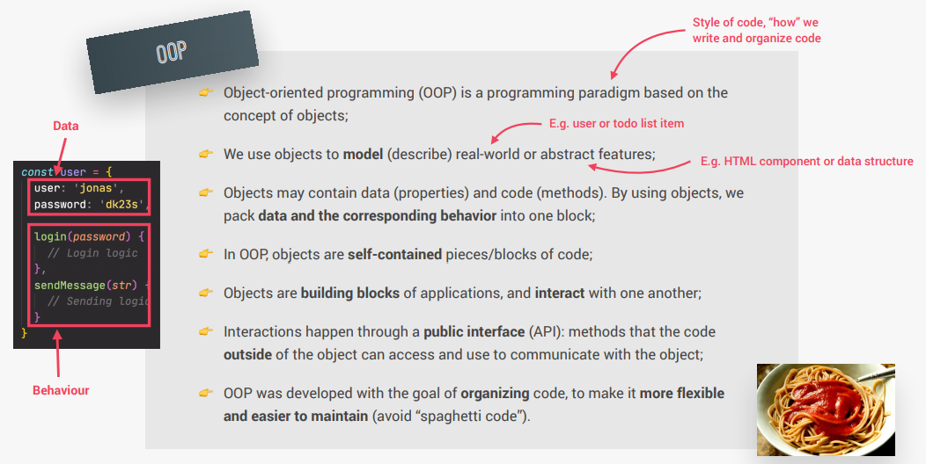
What is OOP – Object oriented programming?

Slide 3
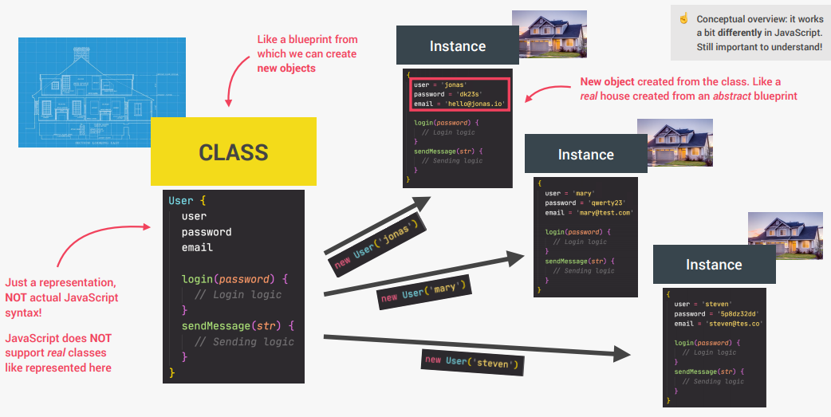
Classes and instances (traditional oop)

Slide 4
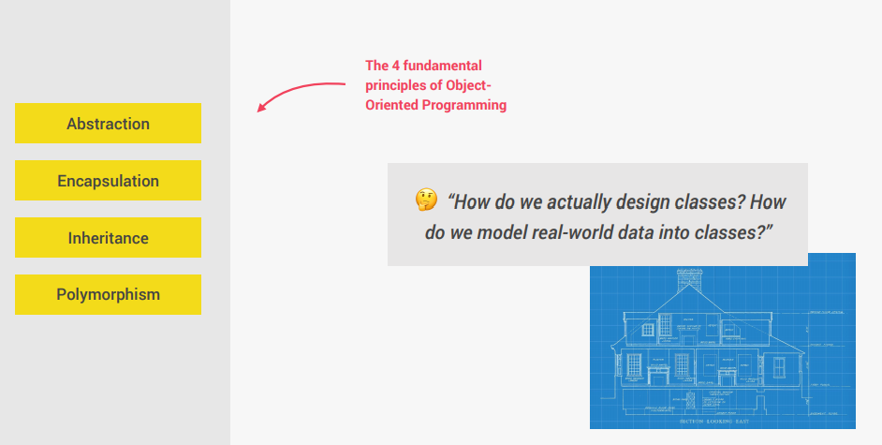
Fundamental oop principles

Slide 5
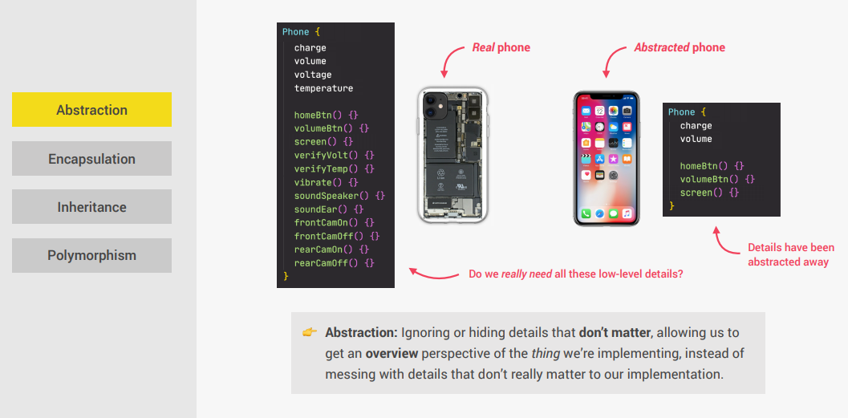
Abstraction

Slide 6
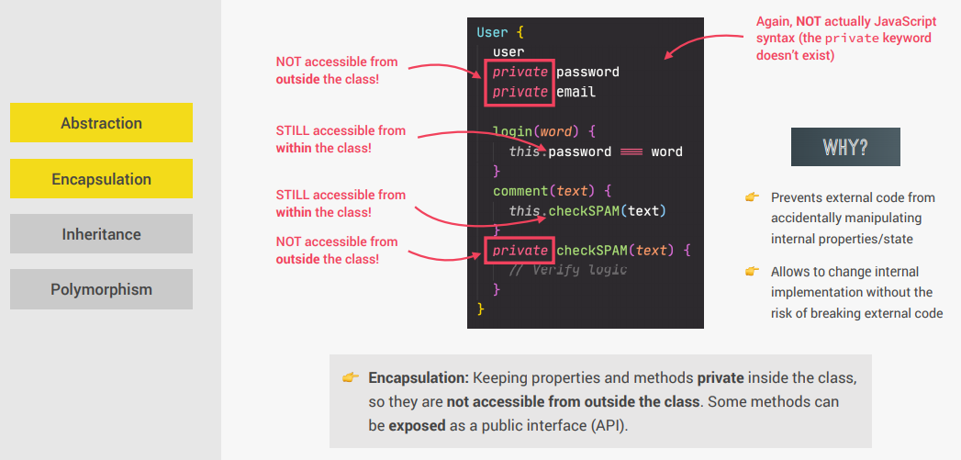
Encapsulation

Slide 7
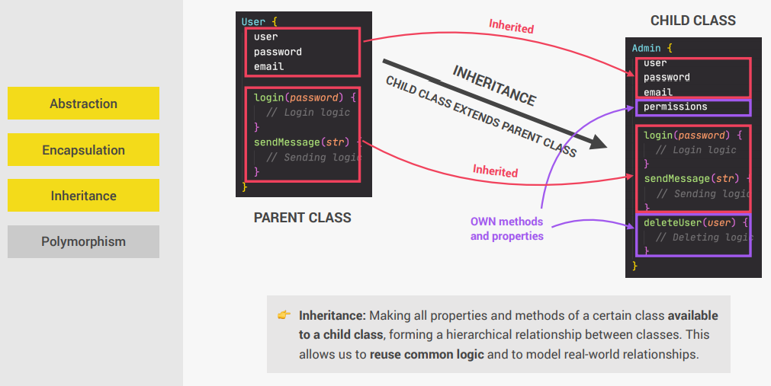
Inheritance

Slide 8
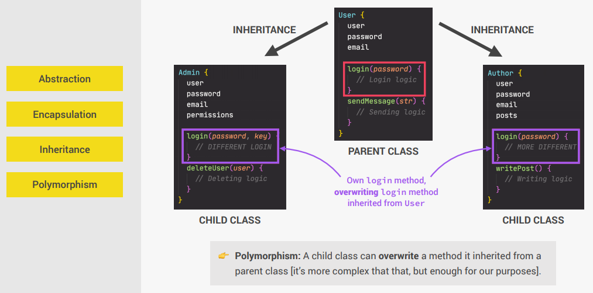
Polymorphism

Slide 9
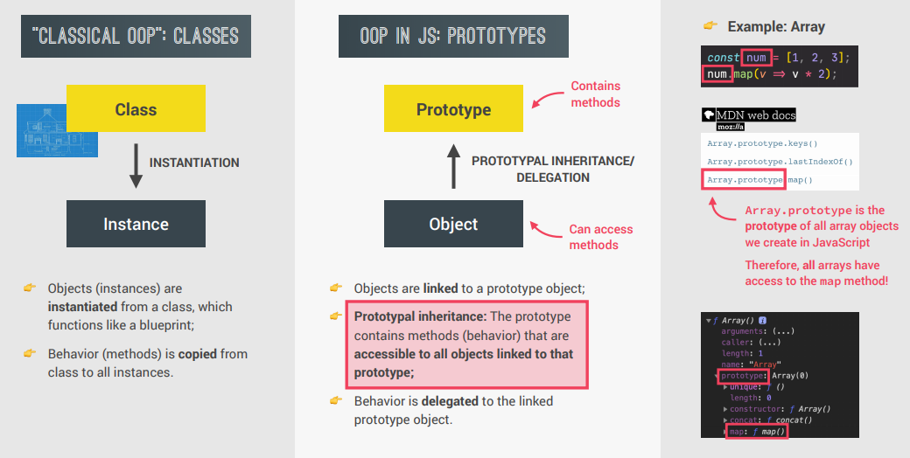
OOP in JavaScript

Slide 10
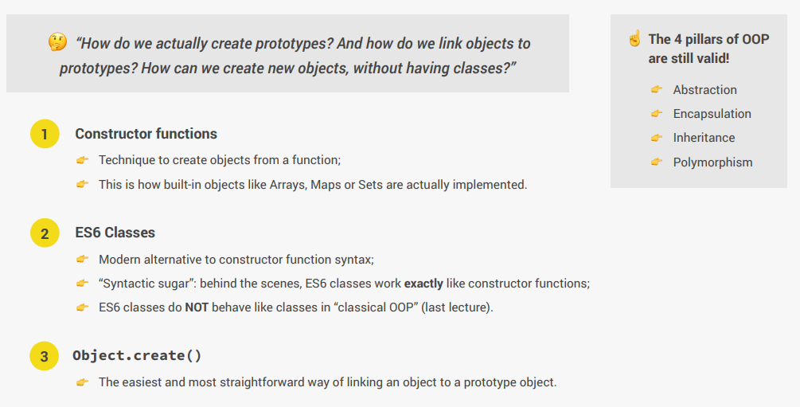
3 Ways of Prototypal inheritance in JS

Slide 11
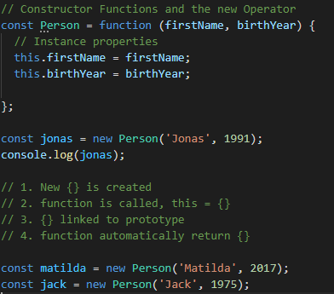
Constructor functions and new operator

Slide 12
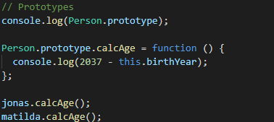

Prototypes
Prototypes will be used to add function, like it would be added to the class in C#
As result we can check __proto__ property:

Slide 13
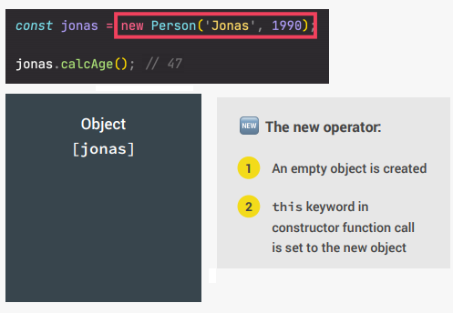
How does this work
When new keyword is used → new empty object is created

Slide 14
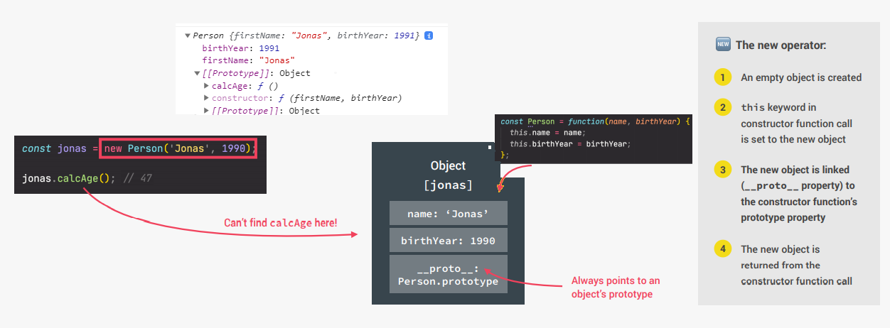
How does this work
When we call the constructor, properties are added to the empty object (so now it’s not empty anymore). But where is the method?

Slide 15
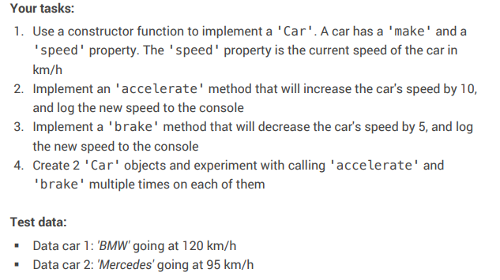
Coding Challenge 1

Slide 16
CLASS - In newer version of JS
So when I mentioned few weeks ago there are no classes in JS, I was not being honest ☺
In newer version of JS we are using classes
They are just a nicer way to work with objects
Behind the scenes code will actually do what we learned in the previous slides
Since it is necessary to understand how it works, we had to go through some hard stuff. Now this part will be familiar

Slide 17
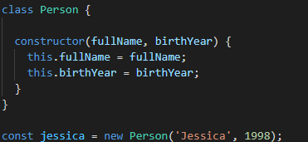
Class
Now let’s make the class Person
See it is somehow similar to code in C#
But pay attention to the constructor

Slide 18
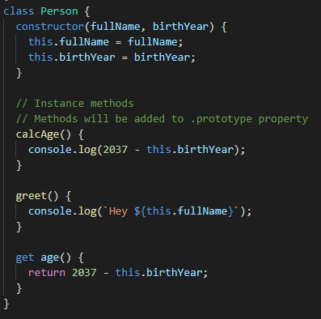
Class can and should have methods
We can now freely add methods and it will look somewhat cleaner than the previous way of declaring Person and its’ methods.

Slide 19
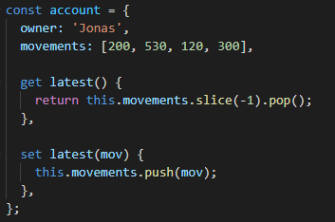

Getters and Setters
Get and Set methods in modern JS
How do we use them? Pay attention they are like properites:
After this let’s go back to Person class and add more get/set props

Slide 20
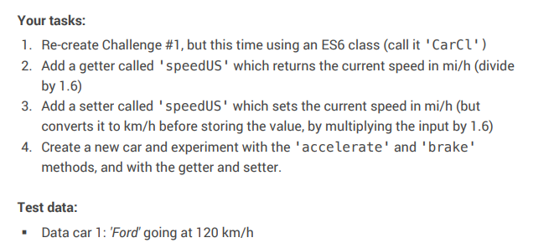
Code Challenge 2

Slide 21
Homework
Create class Employee
The class should have the properties: firstName, lastName, jobTitle and dateOfEmployment
Make sure all properties have ability of get and set.
Class should have the method ShowInfo that will show:
Employee Michael Jordan is working as Basketball player and joined the company on 1998.05.01
Create new objects, one as above: Michael Jordan, and one for person of your choice.

